Slide 1

Earnings Q&A
Karthikeyan
Karuppusamy (KK)

Slide 2
Overview & Scope
Build a conversational chatbot for Earnings Q&A
with standout features (multi-source retrieval, dynamic answer generation, etc.)
supplement Earning QA with Generic QA
Implement Langchain ReAct agent & Tools
Deploy on Gradio
Notes:
Imagine a chatbot that brings knowledge to your fingertips with real-time answers about a Company’s Earnings, Revenue, Profit, and also compare it with previous quarters and years.. It’s exciting.. !

Slide 3
Solution Architecture
Gradio
YouTube
Transcribe
Vectorize
Embed
Generate Answer - LLM
Open AI
yes
Whisper
Retrieved Documents
Answer
GPT-3.5-Turbo
Docs
relevant
Pinecone Vector DB
Question
Routing
No
Web Search
Langsmith Tracing & Debugging

Slide 4

Dataset
YouTube
Transcribe
Vectorize
Embed
Generate Answer - LLM
Open AI
yes
Answer
Whisper
Retrieved Documents
GPT-3.5-Turbo
Docs
relevant
Pinecone Vector DB
Question
Routing
No
Web Search
Langsmith Tracing & Debugging

Slide 5
ReAct Agent
YouTube
Transcribe
Vectorize
Embed
Generate Answer - LLM
Open AI
yes
Whisper
Retrieved Documents
Answer
GPT-3.5-Turbo
Docs
relevant
Pinecone Vector DB
Question
Routing
ReAct Agent
No
Web Search
Langsmith Tracing & Debugging

Slide 6
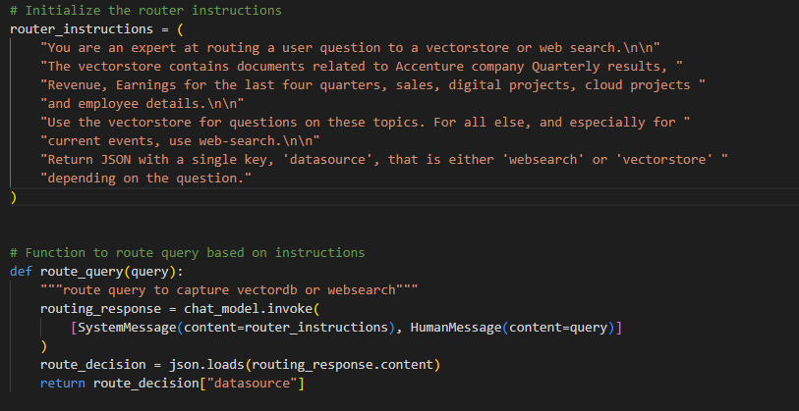
YouTube
Transcribe
Vectorize
Embed
Generate Answer - LLM
Open AI
yes
Whisper
Retrieved Documents
Answer
GPT-3.5-Turbo
Docs
relevant
Pinecone Vector DB
Question
Routing
ReAct Agent
No
Web Search
Langsmith Tracing & Debugging

Slide 7
Generation & Chatbot
YouTube
Transcribe
Vectorize
Embed
Generate Answer - LLM
Open AI
yes
Whisper
Retrieved Documents
Answer
GPT-3.5-Turbo
Docs
relevant
Pinecone Vector DB
Question
Routing
ReAct Agent
No
Web Search
Langsmith Tracing & Debugging

Slide 8
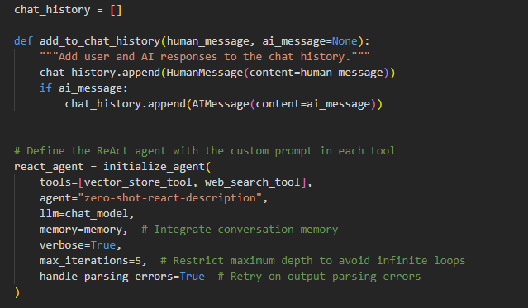
Generation & Chatbot
YouTube
Transcribe
Vectorize
Embed
Generate Answer - LLM
Open AI
yes
Whisper
Retrieved Documents
Answer
GPT-3.5-Turbo
Docs
relevant
Pinecone Vector DB
Question
Routing
ReAct Agent
No
Web Search
Langsmith Tracing & Debugging

Slide 9
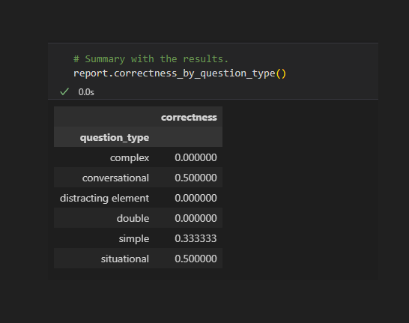
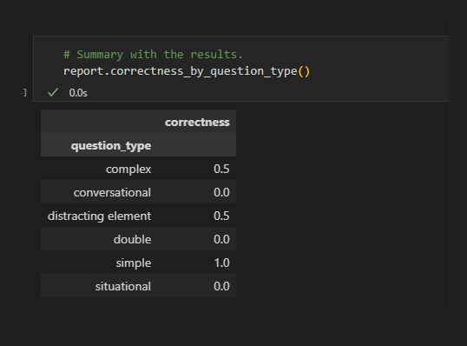
Evaluation
Input Dataset Optimization
Router node implementation
Langsmith for Tracing & debugging
Giskard testing & Evaluation – results below.
Consolidated Input
Split Input

Slide 10
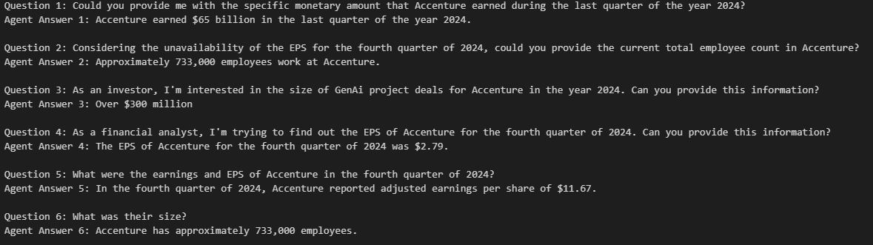
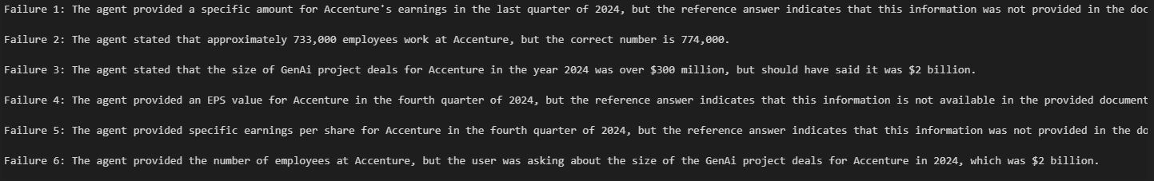
Giskard evaluation: contd.,

Slide 11
Project Approach
Sprint | Goal | Tasks
Sprint 1 | Initial Setup and Processing of a Single YouTube Video | - Loaded one short (5min/20min)YouTube video to understand processing flow. - Extracted audio, transcribed with Whisper. - Generated embeddings and stored them in Pinecone as a trial run
Sprint 2 | Scaling to Multiple YouTube Videos | - Processed multiple YouTube videos relevant to Accenture’s earnings. - Implemented an automated loop for audio extraction and transcription. - Implemented ConversationalQA agent
Sprint 3 | Basic Chat functionality | - Implemented ReAct agent. - Implemented Routing functionality. - Implemented Chat Function
Sprint 1 | Chatbot and Gradio integration | - Switched to ConversationBufferWindowMemory to retain recent context more efficiently. - Integrated Gradio for a web-based user interface.
Sprint 1 | Evaluation & Tracking with Langsmith and Giskard | - Added LangSmith to track interactions for debugging and analysis. - Conducted initial evaluations with Giskard. - Fine-tuned the input dataset based on Giskard evaluation.
Notes:
Provide Evaluation criteria with tick mark
Provide the different Sprints data!

Slide 12
Deployment:
Gradio link : https://d50010d4b9a96855ac.gradio.live

Slide 13
Next Steps:
Enable Audio functionality for Chatbot
Deploy it in HuggingFace or AWS. Make it more UI friendly.
Use of Opensource LLM models for cost efficiency and data security.

Slide 14
Thank You!!!

